Slide 1
Percentages & Mean, Median, Mode with M&M’s: Hands-on Activity
Amanda Giarrizzo

Slide 2
Goals & Objectives
Goals
The student will develop an understanding of percentages, decimals, and fractions.
The student will develop an understanding of mean, median, and mode.
Objectives
Given a cup of approximately 100 M&M’s, the students will count and record the total amount of each color M&M on their worksheet, then calculate their percentages using fractions and decimals, with at least 85% accuracy.
Given the data from the table, the students will calculate the mean, median, and mode of each color and fill in the table, with at least 85% accuracy.

Slide 3
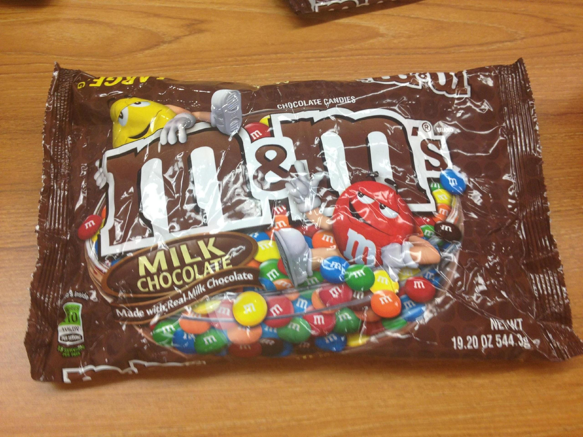
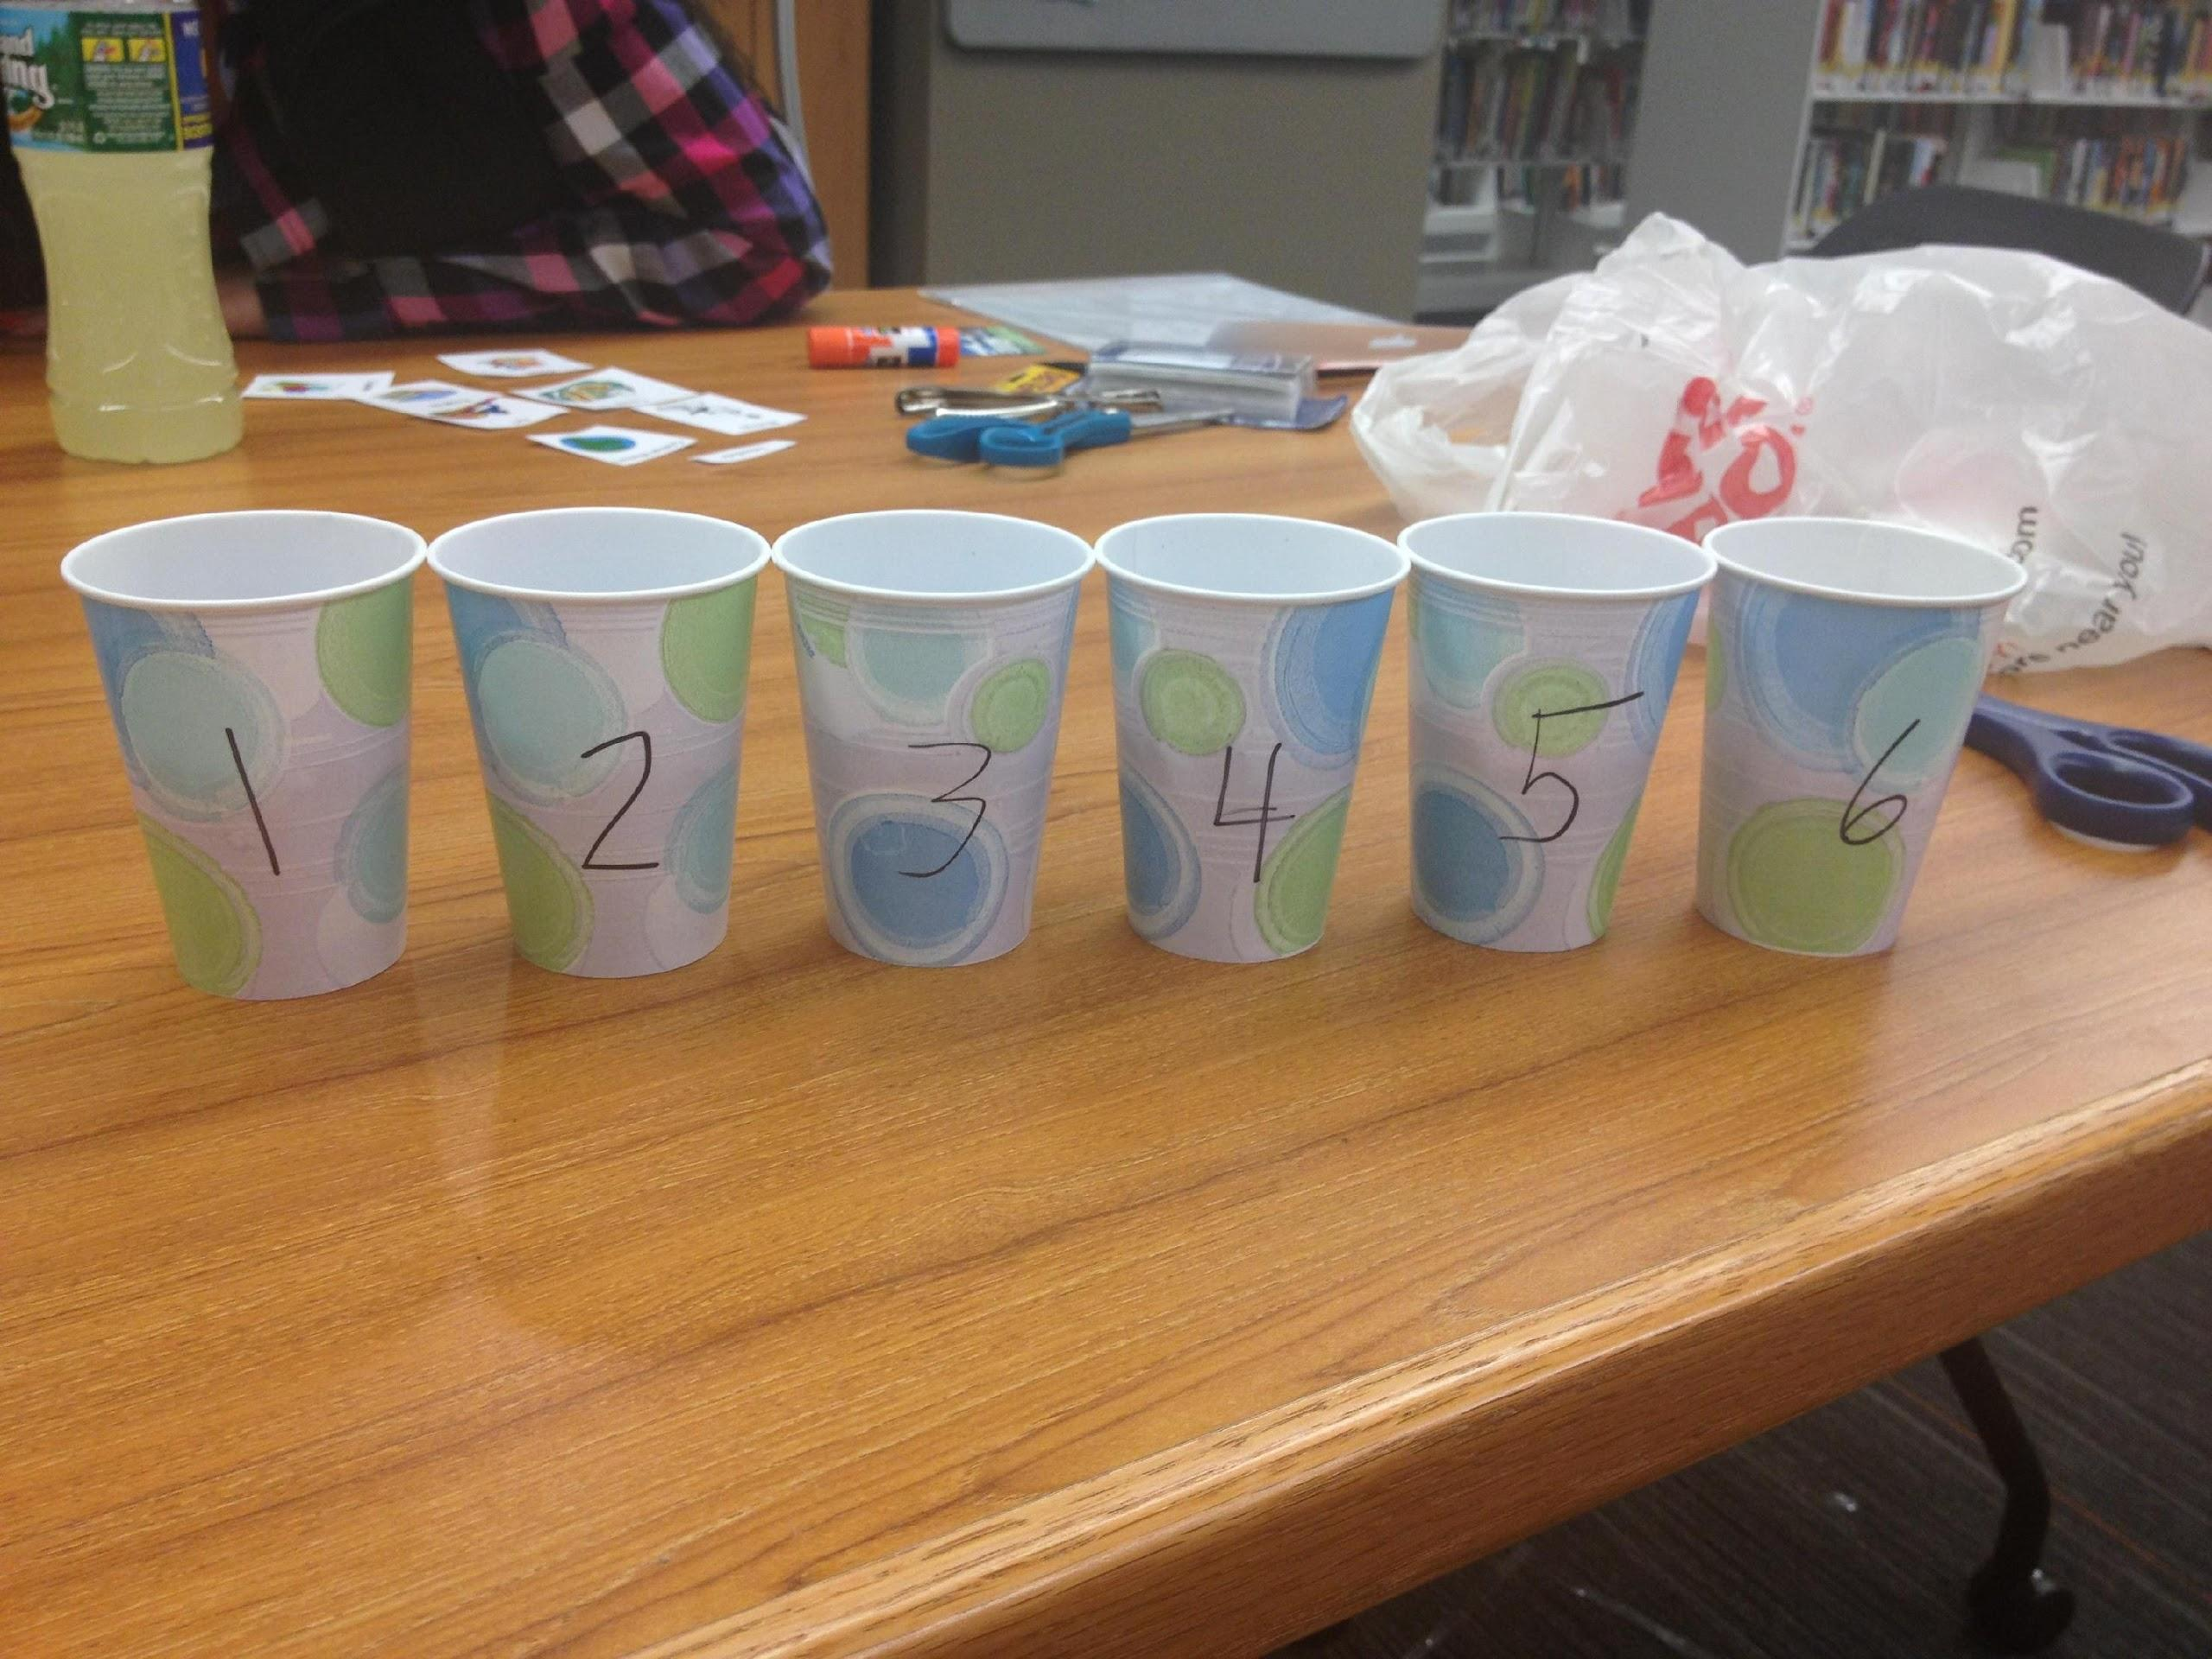
Materials Needed
1 19.2 OZ bag of Large Milk Chocolate M&M’s
6 cups labeled 1-6
Worksheet
Pencil
Napkin

Slide 4
Different Levels of Learning
For Upper Elementary Level
Use this activity to extend their knowledge in working with fractions, decimals, and percentages.
Demonstrates the connection between the three.
For Middle/High School Level
Reinforce mean, median, and mode skills/strategies.

Slide 5
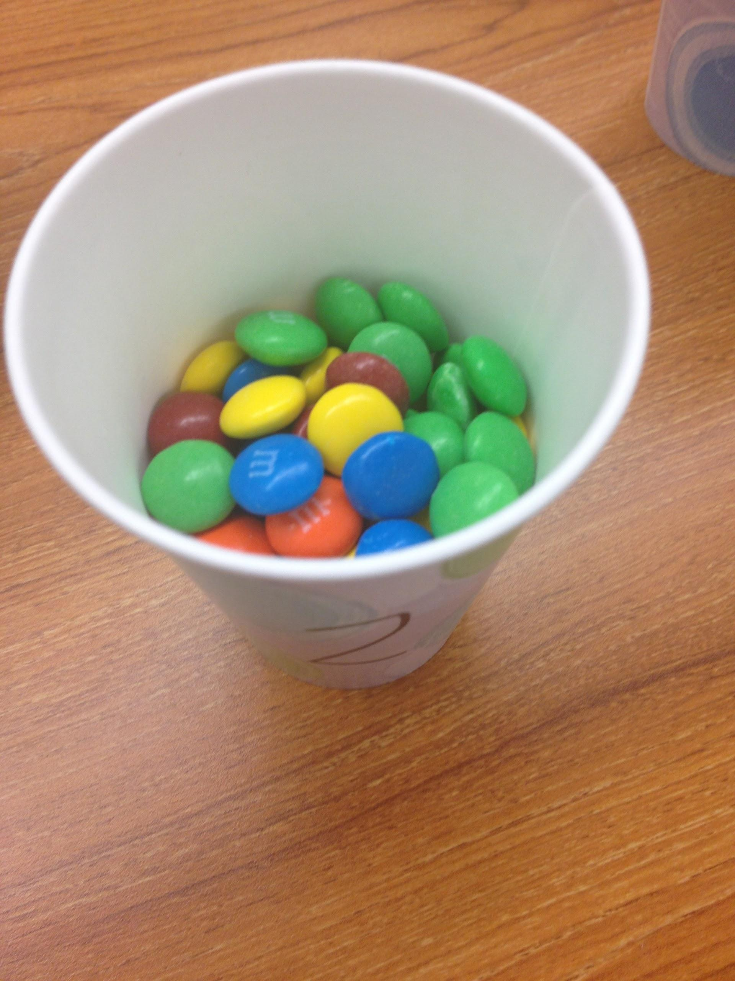
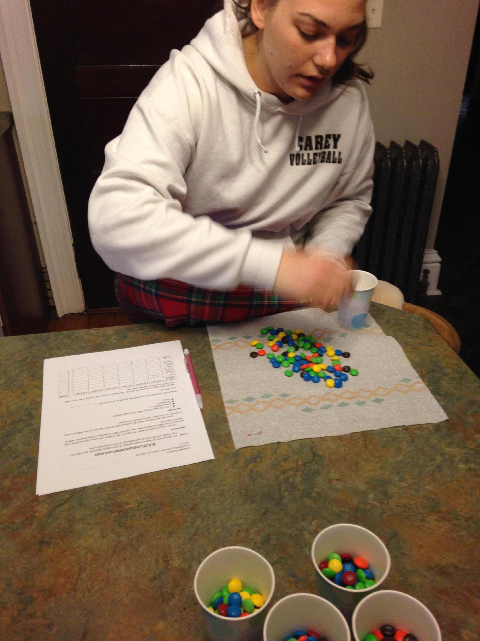
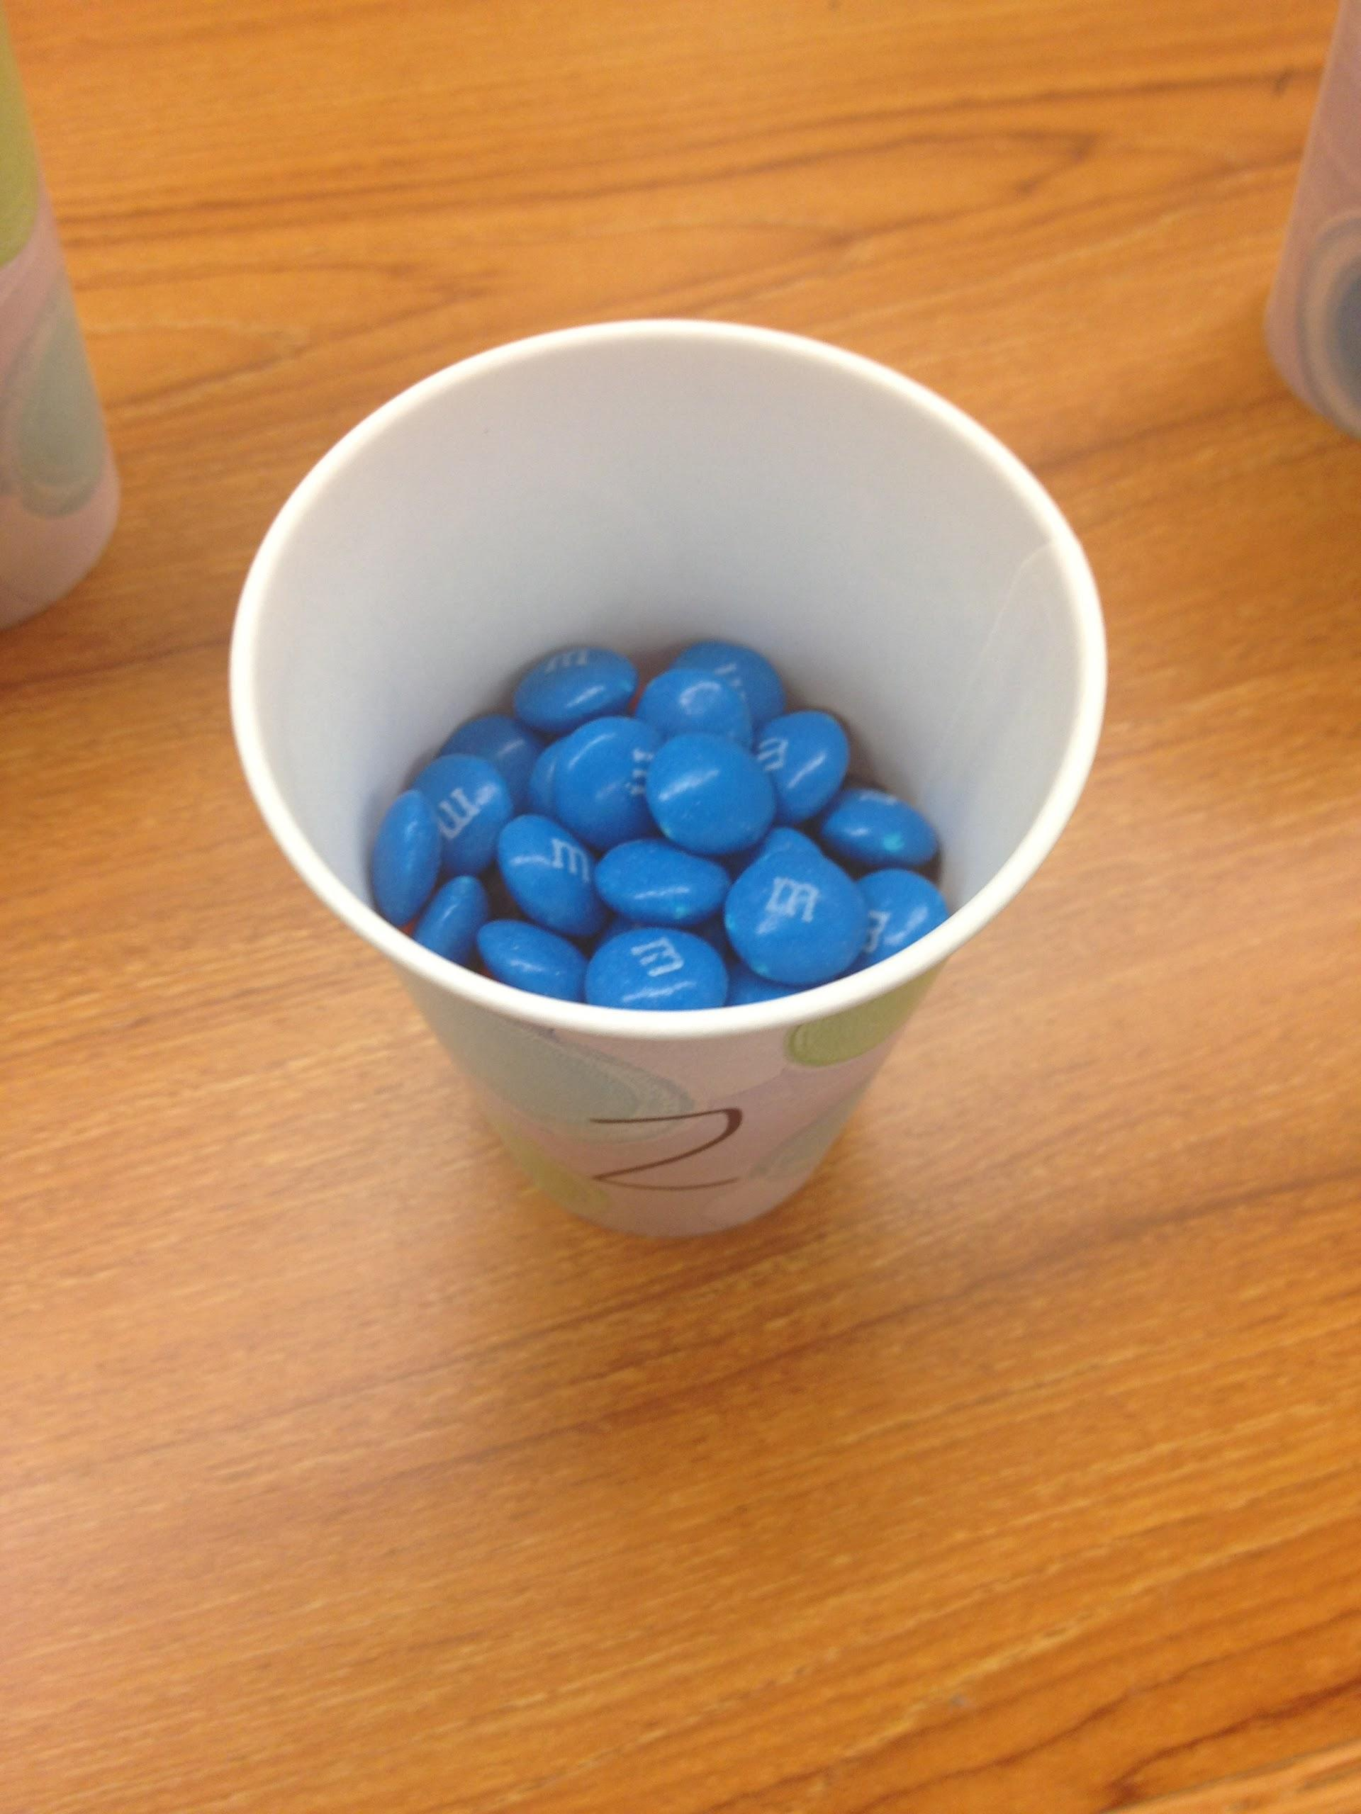
Experiment- Upper Elementary Level
Which color of M&M’s do you think shows up most in the bag? Least? Are they evenly distributed?
Get into groups of 2 or 3
Each group is going to receive 1 cup of M&M’s
Record the number of Red, Orange, Yellow, Green, Blue, and Brown M&M’s in your cup, on the worksheet
Calculate the Total amount of M&M’s in your cup and enter it on the bottom line where it says Total
Copy the totals from the other groups that are on the board

Slide 6
Experiment- Upper Elementary Level
Color of M&M’s | Cup 1 | Cup 2 | Cup 3 | Cup 4 | Cup 5 | Cup 6 |  | Total
Red
Orange
Yellow
Green
Blue
Brown
Total:

Slide 7
Experiment- Upper Elementary Level
Color of M&M’s | # in Cup 1 | # in Cup 2 | # in Cup 3 | # in Cup 4 | # in Cup 5 | # in Cup 6 |  | Total
Red | 22 | 10 | 13 | 11 | 23 | 10 |  | 89
Orange | 10 | 10 | 11 | 14 | 9 | 18 |  | 72
Yellow | 14 | 7 | 17 | 14 | 13 | 9 |  | 74
Green | 25 | 23 | 23 | 23 | 24 | 22 |  | 140
Blue | 24 | 31 | 19 | 30 | 23 | 25 |  | 152
Brown | 10 | 13 | 5 | 20 | 12 | 16 |  | 76
Total: | 105 | 94 | 88 | 112 | 104 | 100 |  | 603

Slide 8
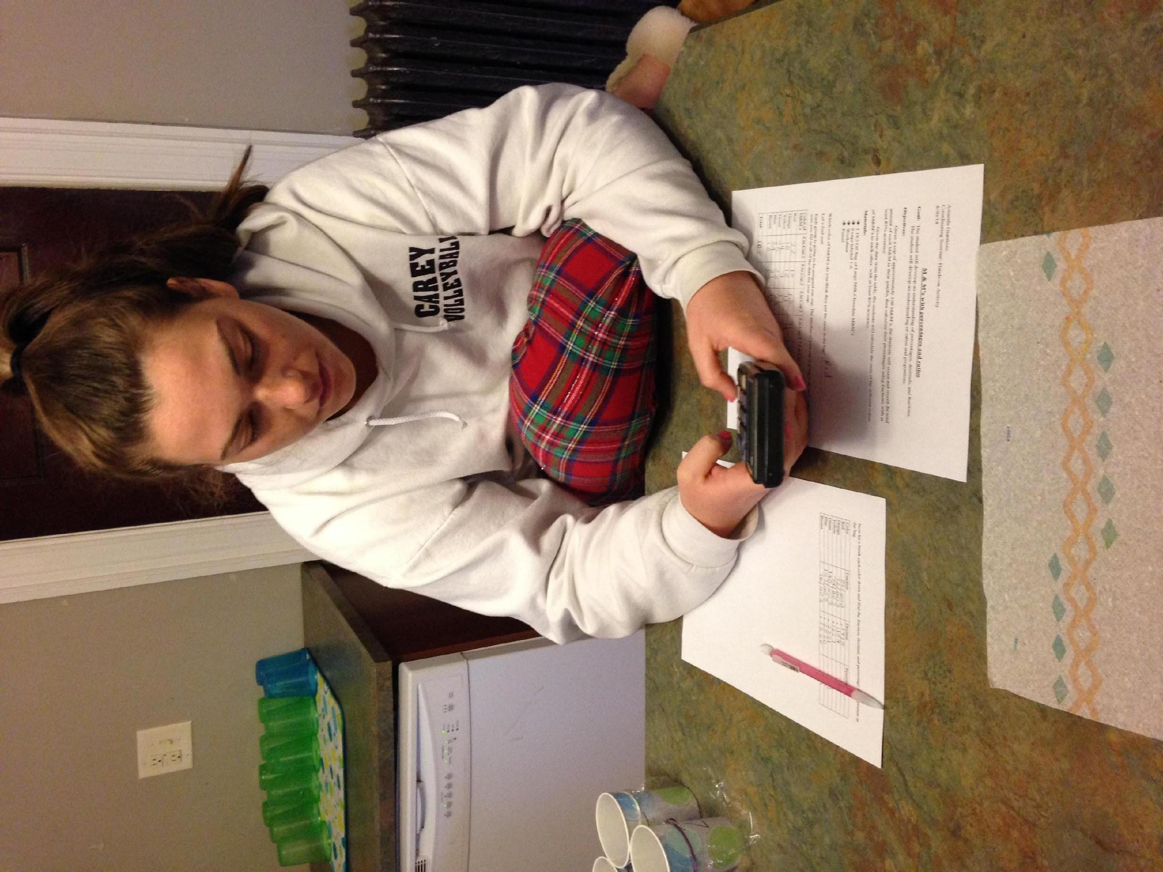
Experiment- Upper Elementary Level
Now that we have the total number of each color M&M and the total number of M&M’s in the bag we can calculate the percentage of each
In order to calculate the percentage, we first need to write a fraction
The fraction will be the number in total of the color we are working with over the total number of M&M’s
Then when we divide we will get a decimal
Once we have our decimal we can find our percentage by multiplying the decimal by 100
Fill in the chart for each color

Slide 9
Experiment- Upper Elementary Level
Color | Fraction | Decimal(nearest ten thousandths) | Percentage(nearest whole number)
Red
Orange
Yellow
Green
Blue
Brown

Slide 10
Experiment- Upper Elementary Level
Color | Fraction | Decimal (to ten-thousandths) | Percentage (rounded to nearest whole number)
Red | 89/603 | .1475 | 15
Orange | 72/603 | .1194 | 12
Yellow | 74/603 | .1227 | 12
Green | 140/603 | .2321 | 23
Blue | 152/603 | .2520 | 25
Brown | 76/603 | .1260 | 13

Slide 11
Experiment- Upper Elementary Level
The student analyzes the data that they have collected and calculated:
Highest percentage
Lowest percentage
Evenly distributed?
Predictions correct?
They can decide if M & M gives an accurate percentage chart.
Extra practice is provided with finding percentages using fractions and decimals.

Slide 12
Experiment- Upper Elementary Level
According to M&M, in each bag of Milk Chocolate M&M’s they include:
Red 13%
Orange 20%
Yellow 14%
Green 16%
Blue 24%
Brown 13%
We concluded that, in this specific bag of Milk Chocolate M&M’s they included:
Red 15%
Orange 12%
Yellow 12%
Green 23%
Blue 25%
Brown 13%

Slide 13
Experiment- Middle School/High School
Can be used as an extension of the lesson done before
Extension would include finding the mean, median, and mode
Decide whether you think M&M uses the mean, median, mode, or a different method to figure out their color percentages
Can be used as a review lesson or prerequisite reinforcing lesson for Mean, Median, and Mode.
Would have the same idea as the Elementary Lesson
6 cups of approximately 100 M&M’s
Chart to fill in the number of each color
Calculate totals
Then using those numbers go through the steps and calculate mean, median, mode.
Decide whether you think M&M uses the mean, median, mode, or a different method to figure out their color percentages

Slide 14
Experiment- Middle School/High School
Color of M&M’s | # in Cup 1 | # in Cup 2 | # in Cup 3 | # in Cup 4 | # in Cup 5 | # in Cup 6 |  | Total
Red | 22 | 10 | 13 | 11 | 23 | 10 |  | 89
Orange | 10 | 10 | 11 | 14 | 9 | 18 |  | 72
Yellow | 14 | 7 | 17 | 14 | 13 | 9 |  | 74
Green | 25 | 23 | 23 | 23 | 24 | 22 |  | 140
Blue | 24 | 31 | 19 | 30 | 23 | 25 |  | 152
Brown | 10 | 13 | 5 | 20 | 12 | 16 |  | 76
Total: | 105 | 94 | 88 | 112 | 104 | 100 |  | 603
Using the chart to the left, follow the steps below to calculate the Mean, Median, and Mode for each color M&M:
Step 1: Look at the row that has Red in it, calculate the mean, record this data on the chart provided on the Handout.
Step 2: Repeat Step 1 for Orange, Yellow, Green, Blue, and Brown M&M’s
Step 3: Look at the row that has Red in it, find the Median, record this data on the chart provided.
Step 4: Repeat Step 3 for Orange, Yellow, Green, Blue, and Brown M&M’s.
Step 5: Look at the row that has Red in it, find the Mode, record this data on the chart provided.
Step 6: Repeat Step 5 for Orange, Yellow, Green, Blue, and Brown M&M’s.

Slide 15
Experiment- Middle School/High School
Mean
R: _____________ O: _____________ Y: ______________
G: _____________ Bl: _____________ Br: ______________
Median
R: _____________ O: _____________ Y: ______________
G: _____________ Bl: _____________ Br: ______________
Mode
R: _____________ O: _____________ Y: ______________
G: _____________ Bl: _____________ Br: ______________

Slide 16
Experiment- Middle School/High School
Mean
R: ___15__________ O: _____12________ Y: _____12_________
G: ___23__________ Bl: _____25________ Br: ____13__________
Median
R: ___12__________ O: ______11_______ Y: ______14________
G: ____23_________ Bl: ______25_______ Br: ______13________
Mode
R: ____10_________ O: ______10_______ Y: ______14________
G: _____23________ Bl: _____________ Br: ______________

Slide 17
Experiment: Middle/High School
Now they will have a chance to think analyze the data that they have collected, specific to their bag of M & M’s.
They can decide whether or not they think that M & M uses mean, median, or mode for their percentages.
Extra practice with finding the Mean, Median, and Mode is provided.

Slide 18
Sources
http://www.walch.com/samplepages/063289.pdf
http://www.exeter.edu/documents/mandm.pdf
http://joshmadison.com/2007/12/02/mms-color-distribution-analysis/

